Slide 1
Diffie Hellman Key Exchange Algorithm Md. Alamgir Hossain Senior Lecturer, Dept. of CSE, Prime University Mail: alamgir.cse14.just@gmail.com

Slide 2

Diffie Hellman Key Exchange Algorithm
Whitefield Diffie and Martin Hellman develop Diffie Hellman key exchange Algorithms in 1976 to overcome the problem of key agreement and exchange.
It enables the two parties who want to communicate with each other to agree on a symmetric key, a key that can be used for encrypting and decryption.
Note that: Diffie Hellman key exchange algorithm can be used for only key exchange, not for encryption and decryption process.
The algorithm is based on mathematical principles.
The algorithm is based on Elliptic Curve Cryptography, a method of doing public-key cryptography based on the algebra structure of elliptic curves over finite fields.
The DH also uses the trapdoor function, just like many other ways to do public-key cryptography.

Slide 3
Algorithm
The first party picks two prime numbers/not primes, g and p and tells them to the second party.
The second party then picks a secret number (let’s call it a), and then it computes gª mod p and sends the result back to the first party; let’s call the result A. Keep in mind that the secret number is not sent to anyone, only the result is.
Then the first party does the same; it selects a secret number b and calculates the result B similar to the step 2. Then, this result is sent to the second party.
The second party takes the received number B and calculates Bª mod p.
The first party takes the received number A and calculates A^{b} mod p.

Slide 4
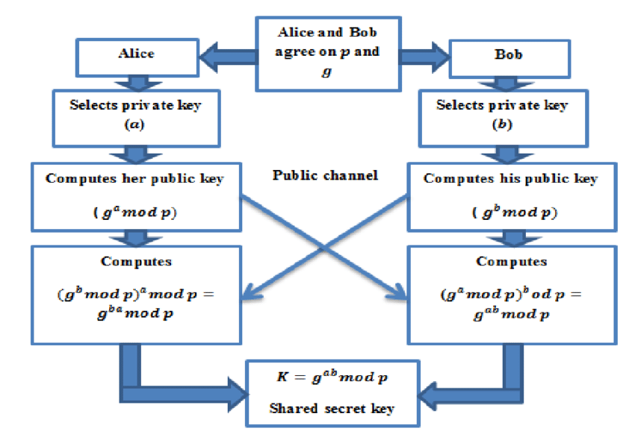
Algorithm

Slide 5
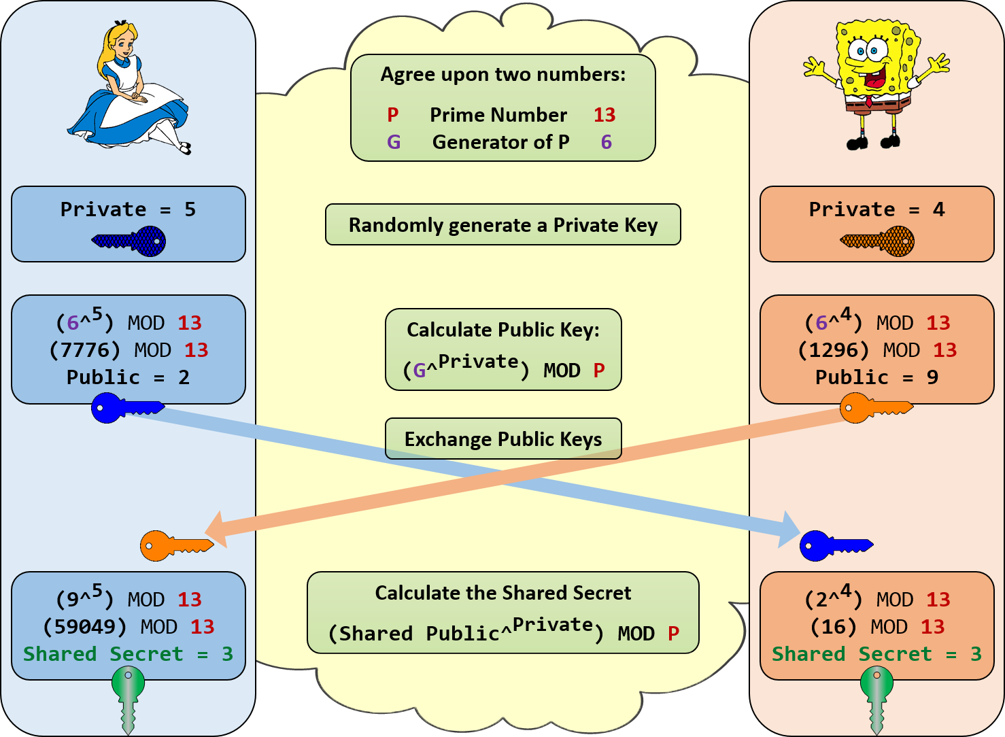
Exampe-01

Slide 6
Example-02
Lets, P = 23, G = 9; a = 4, b = 3.
Sender: A = Gª mod P = 9⁴ mod 23 = 6, Receiver: B = G^{b} mod P = 9³ mod 23 = 16.
Sender Receive: B = 16, Receiver Receive: A = 6.
Sender Calculate: Bª mod p = 16⁴ mod 23 = 9.
Receiver Calculate: A^{b} mod p = 6³ mod 23 = 9.
9 is the shared secret.

Slide 7
Advantages of DH Algorithm
Public Key Infrastructure: The public-key infrastructure (PKI) is a set of tools and rules to enforce public key cryptography with multiple entities. It also governs the issuance of digital certificates over the internet to maintain data confidentiality. With the Diffie-Hellman algorithm as the base, the PKI system was created to enable the exchange of public keys with anyone who requests for it and has the appropriate permissions.
SSL/TLS Handshake: Internet browsers are authenticated with website servers using an SSL/TLS (Secure Sockets Layer/Transport Layer Security) certificate and many keys. This is possible only because of the key exchange algorithm, which enables the secure exchange of cryptographic entities over all channels.
Secure Shell Access (SSH): SSH is a cryptographic protocol used to access system terminals from a third-party appliance or application. The Diffie-Hellman algorithm assists in exchanging the keys between both systems before enabling remote access.
Password Authenticated Agreement

Slide 8
Advantages of DH Algorithm
The sender and receiver don’t need any prior knowledge of each other.
Once the keys are exchanged, the communication of data can be done through an insecure channel.
The sharing of the secret key is safe.

Slide 9
Disadvantages of DH Algorithm
It can not be used for signing digital signatures.
Since it doesn’t authenticate any party in the transmission, the Diffie Hellman key exchange is susceptible to a man-in-the-middle attack.

Slide 10
How does Man-in-the Middle Attack

Slide 11
Man-in-the Middle Attack
A MITM attack is a form of cyber-attack where a user is introduced with some kind of meeting between the two parties by a malicious individual, manipulates both parties and achieves access to the data that the two people were trying to deliver to each other.
A man-in-the-middle attack also helps a malicious attacker, without any kind of participant recognizing till it's too late, to hack the transmission of data intended for someone else and not supposed to be sent at all.
If an attacker puts himself between a client and a webpage, a Man-in-the-Middle (MITM) attack occurs. This form of assault comes in many different ways.
For example, In order to intercept financial login credentials, a fraudulent banking website can be used. Between the user and the real bank webpage, the fake site lies "in the middle."

Slide 12
How does Man-in-the Middle Attack Works
There are several reasons and strategies for hackers to use a MITM attack.
Usually, like credit card numbers or user login details, they try to access anything. They also spy on private meetings, which may include corporate secrets or other useful information.
The feature that almost every attack has, in general, is that the attacker pretends to be somebody you trust (or a webpage).

Slide 13
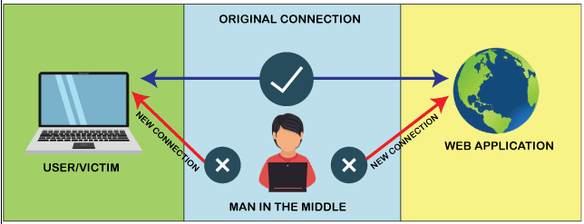
How does Man-in-the Middle Attack Works

Slide 14
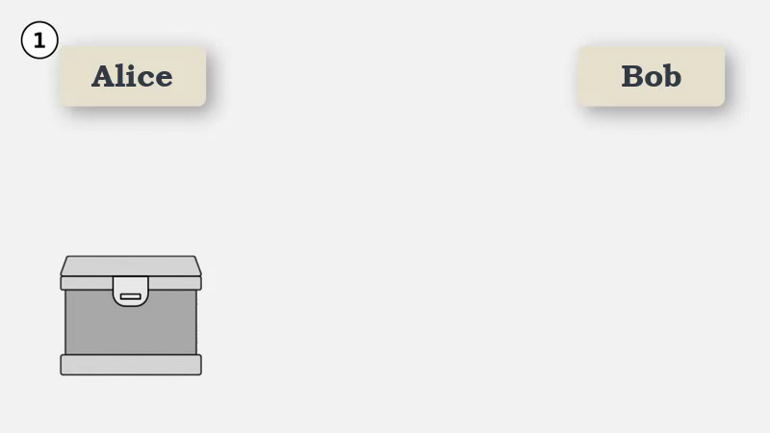
Man-in-the Middle Attack

Slide 15
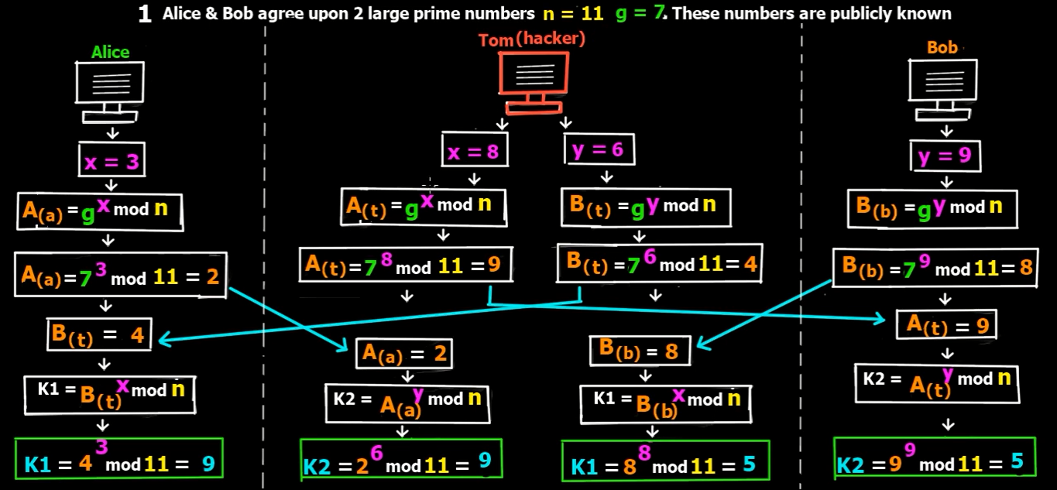
Man-in-the Middle Attack in DH

Slide 16
Types of Man-in-the Middle Attack
Wi-fi Eavesdropping
DNS Spoofing
IP Spoofing
HTTPS Spoofing
ARP Spoofing
E-mail Hacking
Session Hacking
SSL Stripping
MITB attack

Slide 17
Preventions of Man-in-the-middle attack
Wireless access point (WAP) Encryption
Use a Virtual Private Network (VPN)
Network Security
Public Key Pair Authentication
Strong Network User Credentials
Communication security
Using proper hygiene for network protection on all platforms, such as smartphone apps
Avoid using public wi-fi

Slide 18
Thank You

